Slide 1
Team presentation-5 NTCIR-15 Dialogue Evaluation Task
組員 : 黃彥鈞、黃顗亘、鄭宇雅、廖容毅

Slide 2
Summary
According to the last presentation, we have faced an issue of predicting probability distribution. Before we usually handled classification problems like single-class, multi-class, and even multi-label classification, it turns out to be probability distribution is a brand new researching field that we have never tried.
In this week’s presentation, we are going to talk about how we predict probability distribution from Keras, and how we customize our own loss function.

Slide 3
Outlines
Learning probability distribution
Customized loss function
Result
Next step

Slide 4
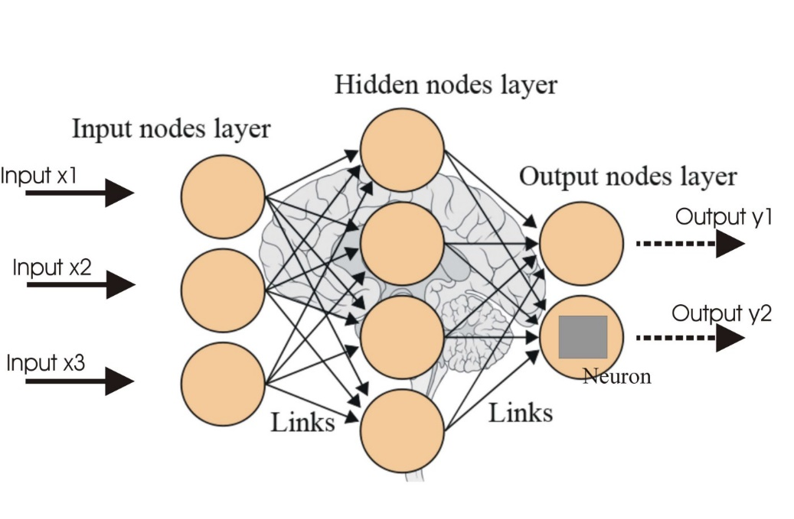
Learning probability distribution
Multi-label vs Multi-output ?
Continuous output?

Slide 5
Customized loss function
Keras provides many commonly used loss functions, but these loss functions are relatively basic and general. Sometimes we need to customize the loss function according to the tasks we do. Although Keras is a very advanced package, it is relatively simple to customize the loss.
Keras loss functions must only take (y_true, y_pred) as parameters
Need to use tensor operations — i.e. operate on tensor instead of numpy array
The returned result is a tensor

Slide 6


Customized loss function
JSD
tf.keras.losses.KLDivergence()
>>> y_true = [[0, 1], [0, 0]]
>>> y_pred = [[0.6, 0.4], [0.4, 0.6]]
>>> kl = tf.keras.losses.KLDivergence()
>>> kl(y_true, y_pred).numpy()
0.458
https://keras.io/api/losses/

Slide 7
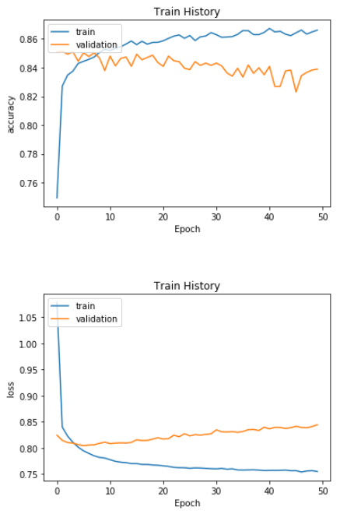
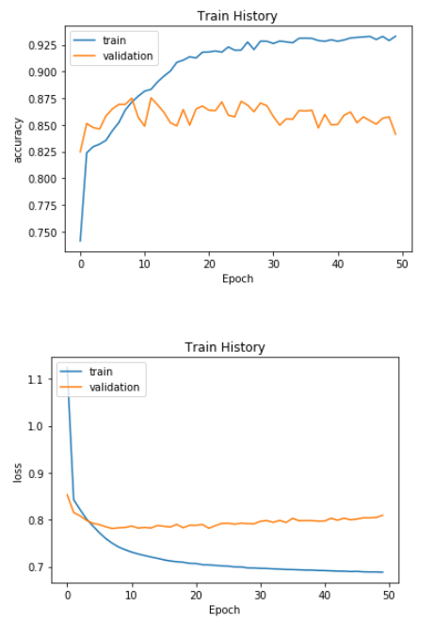
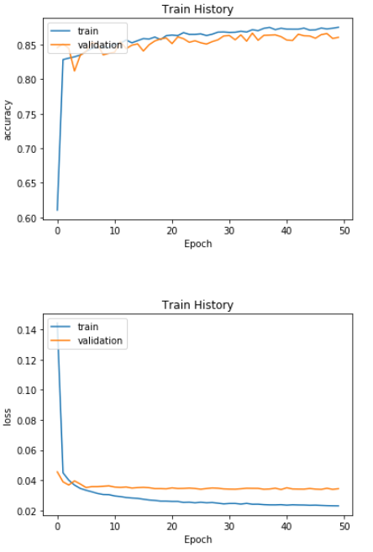
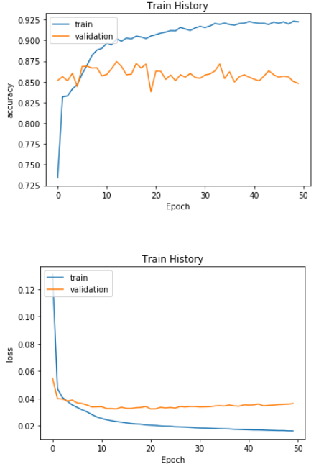
Categorical_crossentropy
Jensen-Shannon Divergence
textCNN LSTM
textCNN LSTM

Slide 8
Result
Calculate the divergence result from output
Sender
Round 1
 | JSD | RNSS
textCNN | 0.06 | 0.16
LSTM | 0.05 | 0.15
textCNN
Round
Layer 1
LSTM
Output
probability distribution
Text
Round 2
 | JSD | RNSS
textCNN | 0.05 | 0.15
LSTM | 0.05 | 0.14
Layer 2

Slide 9
Next step
Separate the input probability distribution customer and helpdesk utterances by id.

Slide 10
Thanks for listening!

